Slide 1
Predicting Hospital Star Ratings
A. Cagle, A. Meshejian, & B. Uehlinger
6 December 2024

Slide 2
Optimizing for Riverside Health System
Reverse-engineering CMS Overall Star Rating

Slide 3
Overall Hospital Quality Star Rating
Group Measures
Calculate Simple Averages
Summarize Scores
Select & Standardize Measures
Apply Minimum Thresholds
Assign Peer Groups
Cluster & Determine Star Rating
Purpose: Summarizes performance across 5 domains into a single metric.
Data Source: Reported by facilities to CMS via quality programs.
7-Step Calculation Process: Developed with stakeholder and public input.
Group Measures: Mortality, Safety, Readmission, Patient Experience, Timely & Effective Care
(Centers for Medicare & Medicaid Services, 2024)

Slide 4
Reverse-Engineering CMS Star Ratings
Data Collection: Retrieved and cleaned data from 10 CMS quality measure datasets for July 2024 measures; combined measures for the 5 groups of interest
Calculation: filtered measures and hospitals, Standardized measure scores, grouped measure scores, created peer groups, performed k-means on summary score for each hospital in each peer group
Validation: Replicated CMS' methodology and cross-validated outputs against CMS results
Analysis & Insights: Identified top predictors and areas for improvement; benchmarked Riverside Health against national and peer averages

Slide 5
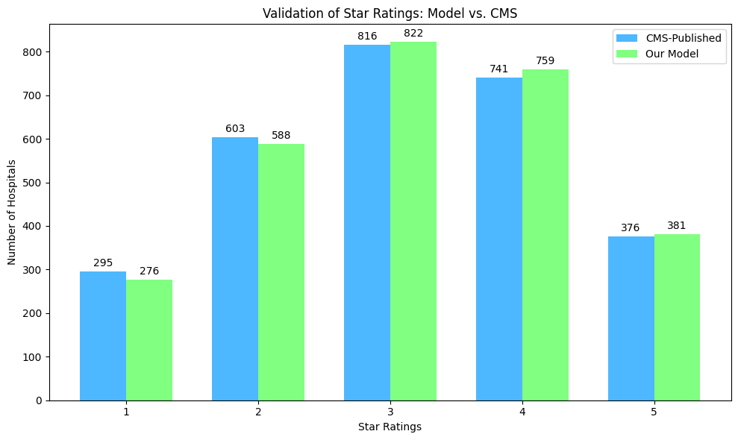
Validation of Results
Key Steps:
Compared calculated star ratings with CMS-published data.
Achieved 98% alignment across 4,658 hospitals for star rating
Observed only 4 differences in measure group counts
Investigated and resolved discrepancies to improve model fidelity.
Results Summary:
Model confirmed robust alignment with CMS methodology.

Slide 6
Riverside Measure Group Scores
Analyses & Insights

Slide 7
Patient Experience
Based on results from the HCAHPS Survey
Riverside performs well in this domain
Opportunity for improvement at Shore and Regional
Patient Experience Group Scores and Ranks (Data from 4/1/2022-3/31/2023)
CCN | Hospital Name | grp_score | Rank
490037 | Riverside Shore Memorial Hospital | 0.340154 | 1211 of 3231
490052 | Riverside Regional Medical Center | 0.214651 | 1344 of 3231
490130 | Riverside Walter Reed Hospital | 0.857175 | 667 of 3231
490143 | Riverside Doctors' Hospital of Williamsburg | 0.783366 | 719 of 3231

Slide 8
Timely and Effective Care
How often or how quickly hospitals provide care that research shows get the best results for patients.
3 of 4 Riverside facilities rank in the top 15% of all hospitals in this domain.
Timely and Effective Care Group Scores and Ranks (Data from 7/1/2021-3/31/2023)
CCN | Hospital Name | grp_score | Rank
490037 | Riverside Shore Memorial Hospital | 1.087315 | 496 of 4588
490052 | Riverside Regional Medical Center | 0.545521 | 1242 of 4588
490130 | Riverside Walter Reed Hospital | 0.978483 | 613 of 4588
490143 | Riverside Doctors' Hospital of Williamsburg | 1.181454 | 419 of 4588

Slide 9
Safety of Care
Examine potentially preventable injury and complications due to care provided during a hospitalization.
Significant variance in performance noted across facilities
Room for improvement at Walter Reed and Doctors' Hospital of Williamsburg
Safety of Care Group Scores and Ranks (Data from 4/1/2019-3/31/2023)*
CCN | Hospital Name | grp_score | Rank
490037 | Riverside Shore Memorial Hospital | 0.616953 | 723 of 3458
490052 | Riverside Regional Medical Center | 0.590496 | 762 of 3458
490130 | Riverside Walter Reed Hospital | -0.165254 | 2329 of 3458
490143 | Riverside Doctors' Hospital of Williamsburg | -0.183387 | 2361 of 3458
*Excludes Q1 and Q2 2020 data for some measures

Slide 10
Readmission
Examine returns to the hospital following a hospitalization.
All Riverside Hospitals struggle for Readmission measures, all below average.
Critical action needed ahead of 2026
Readmission Group Scores and Ranks (Data from 7/1/2019-6/30/2022)*
CCN | Hospital Name | grp_score | Rank
490037 | Riverside Shore Memorial Hospital | -0.062829 | 2486 of 4387
490052 | Riverside Regional Medical Center | -0.378694 | 3083 of 4387
490130 | Riverside Walter Reed Hospital | -0.150489 | 2664 of 4387
490143 | Riverside Doctors' Hospital of Williamsburg | -0.036087 | 2432 of 4387
*Excludes Q1 and Q2 2020 data for some measures

Slide 11
Mortality
Examine death rates in the 30 days following a hospitalization.
An area of significant opportunity
Vital for Riverside to focus on ahead of 2026
Mortality Group Scores and Ranks (Data from 7/1/2019-6/30/2022)*
CCN | Hospital Name | grp_score | Rank
490037 | Riverside Shore Memorial Hospital | -1.377888 | 3263 of 3582
490052 | Riverside Regional Medical Center | -1.907913 | 3460 of 3582
490130 | Riverside Walter Reed Hospital | -0.677782 | 2779 of 3582
490143 | Riverside Doctors' Hospital of Williamsburg | 0.201394 | 1565 of 3582
*Excludes Q1 and Q2 2020 data for some measures

Slide 12
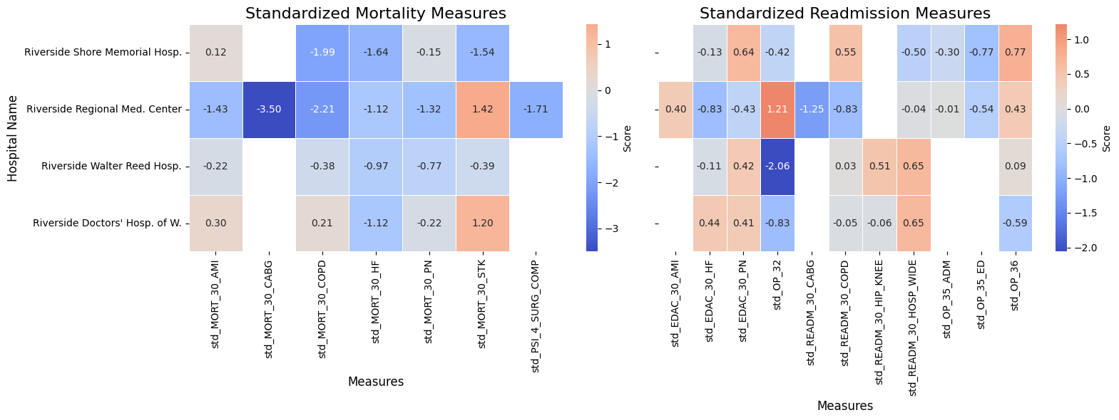
Mortality & Readmission Heat Map

Slide 13
Riverside Regional Medical Ctr. - CABG
Hospitals with poor performance on the STD_MORT_30_CABG measure face higher-than-expected mortality rates for coronary artery bypass graft (CABG) procedures. Below are some research-based methods to improve CABG outcomes.
Advanced Surgical Techniques: Off-Pump CABG: Performing CABG without cardiopulmonary bypass (off-pump) reduces mortality and morbidity, especially for high-risk patients.
Optimal Graft Selection: Arterial Grafts: Using arterial grafts (e.g., internal thoracic artery) is associated with better long-term outcomes compared to vein grafts.
Comprehensive Risk Assessment: Comorbidity Focus: Patients with conditions like diabetes, COPD, or kidney disease are at higher risk. Preoperative optimization and tailored interventions improve outcomes.
(Journal of Cardiothoracic Surgery)
(Coronary Artery Bypass Grafting: Past and Future)

Slide 14
All Riverside Locations- HF
Hospitals with poor performance on the STD_MORT_30_HF measure face higher-than-expected 30-day mortality rates for heart failure (HF) patients.
Multidisciplinary Heart Failure Clinics
Transitional Care Programs
Structured Discharge & Follow-Up
Medication Adherence Interventions
Boosting Compliance
Comprehensive Care Approach through diverse teaming.
Coordinated care through HF clinics improves survival rates and reduces hospitalizations.
Thorough discharge planning and timely follow-ups (e.g., telehealth, home visits) lower readmission rates and enhance outcomes.
Ensuring HF patients adhere to prescribed medications significantly reduces mortality and readmissions. Regular follow-ups should reinforce adherence.
(Journal of Cardiothoracic Surgery)
(JAMA Network Open)
(Systematic Review and Meta-Analysis of HF Interventions)

Slide 15
Using Machine Learning to Assess Measure Importance
Key Drivers of Hospital Star Ratings

Slide 16
ML Feature Importance
To better understand the key drivers behind hospital star ratings, we analyzed feature importance using three machine learning algorithms. By leveraging these standardized models, we identified which variables most significantly influence the prediction of star ratings. Below are the three methods used.
Random Forest
Measures variance reduction or Gini impurity.
Highlights features that consistently reduce uncertainty in decision trees.
XGBoost
Measures gain-based importance (improvement in loss function).
Prioritizes features reducing model error during training.
Gradient Boosted Machine (GBM)
Similar to Random Forest.
Aggregates total reduction in variance or error across all boosted trees.

Slide 17
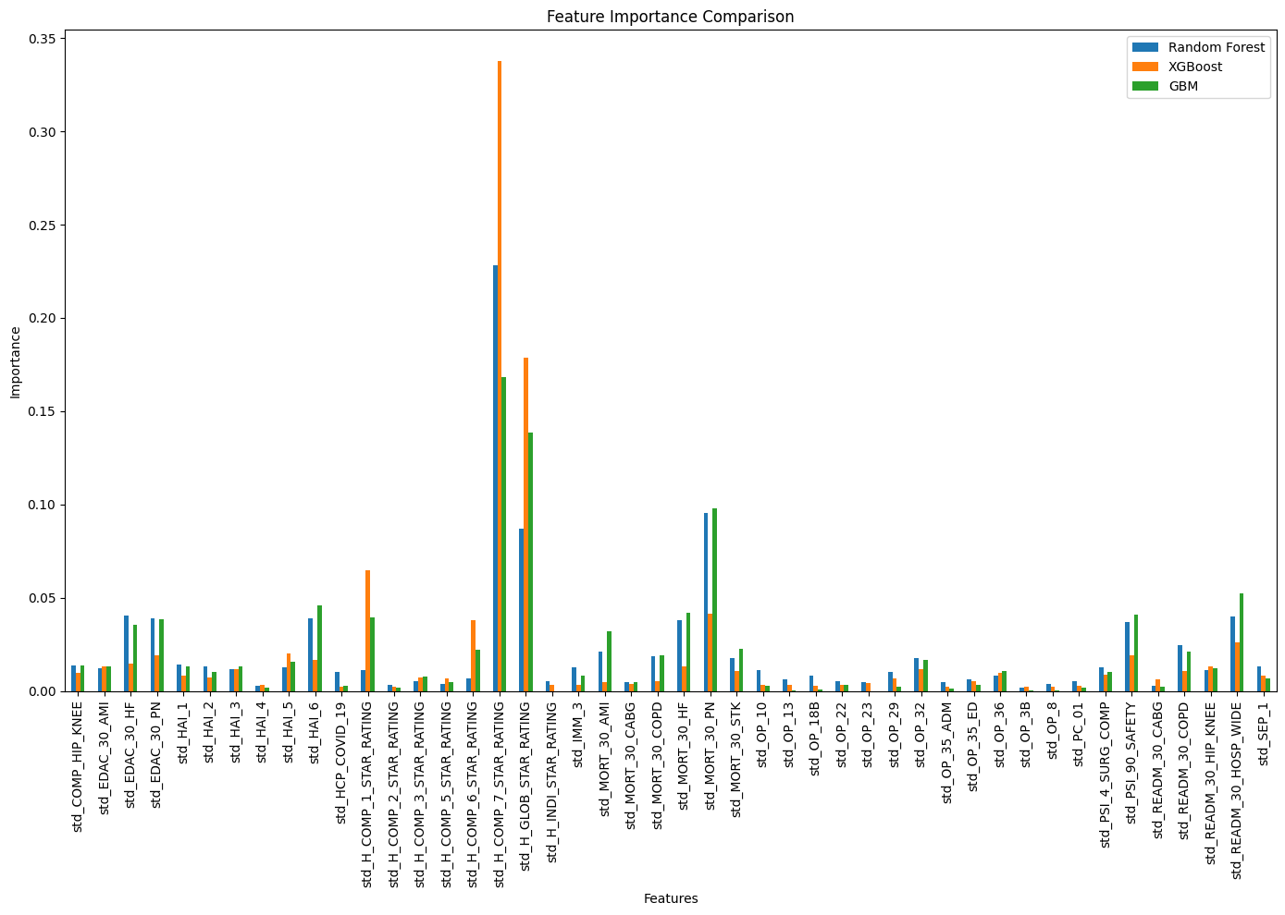
Top Drivers
Care Transitions: HCAHPs 7 Star Rating
Perception of Care: HCAHPs Global Star Rating
Std_MORT_30_PN: Pneumonia 30-Day Mortality

Slide 18
H-COMP-7: Care Transition Ratings
In the HCAHPS survey, patients rank how closely they agree with these statements regarding care transition:
During this hospital stay, staff my preferences and those of my family or caregiver into account in deciding what my health care needs would be when I left.
When I left the hospital, I had a good understanding of the things I was responsible for in managing my health.
When I left the hospital, I clearly understood the purpose for taking each of my medications.
(Hcahpsonline.org, 2024)

Slide 19
The 2026 Star Rating Cycle
Considering the Future

Slide 20
2026 Changes to Star Rating Calculation
3 New Measures
Kidney Health Evaluation for Patients with Diabetes
Improving or Maintaining Physical Health
Improving or Maintaining Mental Health
🆕 These measures reflect CMS’ focus on holistic and preventative care.
Weight Adjustments
Physical and Mental Health Measures
Weight = 1 in 2026
Weight = 3 in 2027
Patients’ Experience/Complaints and Access Measures
Weight reduced from 4 ➡️ 2
📉 Decreased emphasis on patient experience to rebalance star ratings.
(Ciancetta, 2024)

Slide 21
Simulating Expected Changes to the Star rating
Considering the Future

Slide 22
PtExp Scenario Analysis Methodology
As discussed in previous slides, the Patient Experience measure, which we have proven to be very important to measuring the Star Rating across all hospitals, is essentially being “halved” for 2026. We performed scenario analysis, rerunning the star rating with the Patient Experience weight cut in half and redistributed among other measures.
CCN | Hospital Name | Original Summary Score | Scenario Summary Score
490037 | Riverside Shore Memorial Hospital | 0.024 | 0.004
490052 | Riverside Regional Medical Center | -0.260 | -0.307
490130 | Riverside Walter Reed Hospital | 0.087 | 0.003
490143 | Riverside Doctors' Hospital of Williamsburg | 0.31 | 0.264

Slide 23
Conclusions
Results, Recommendations, & Next Steps

Slide 24
Results
📊 Key Findings:
Strong performance in Timely and Effective Care (Top 10% nationally for Riverside Doctors' Hospital).
Opportunities in Readmission and Mortality domains, with scores below average for most facilities.
Variability in Patient Experience and Safety of Care measures, highlighting areas for targeted improvement.

Slide 25
Recommendations
✔️ Actionable Strategies:
Implement post-discharge follow-up programs to address readmissions and provide strong care transition.
Enhance staff training for communication and discharge planning to improve Patient Experience.
Adopt infection control protocols and real-time safety monitoring for Safety of Care improvements.
Focus on early intervention for high-risk patients, and clearly document comorbidities to improve Mortality scores.

Slide 26
Next Steps
🚀 Future Focus:
Launch Centralized Monitoring Dashboard to track metrics and ensure accurate CMS reporting.
Prepare for 2026 CMS Updates by bolstering performance in Mortality and Safety of Care to mitigate risks from reduced Patient Experience weight.
Benchmark against top-performing peers to adopt best practices and drive competitive positioning.
Continue using the predictive model for proactive trend analysis and early interventions.

Slide 27
Deliverables
Artifacts & Documentation
Minimum Viable Product (MVP) for Data Analysis and Predictive Modeling
Staging database with star value data from 2017 through 10/2024
Replicated CMS Star Rating Model Code
Technical Report Detailing Methodology and Findings
Summary Presentation Deck

Slide 28
Thank You
Q&A

Slide 29
References
Centers for Medicare & Medicaid Services. (2024). Hospital Compare. Retrieved from https://www.cms.gov
Ciancetta, M. (n.d.). Navigating changes in Star Rating programs: Enhancing success with four key steps. Cotiviti. Retrieved December 1, 2024, from https://resources.cotiviti.com/quality-measurement-and-reporting/navigating-changes-in-star-rating-programs-enhancing-success-with-four-key-steps
Guan, Z., Guan, X., Gu, K. et al. Short-term outcomes of on- vs off-pump coronary artery bypass grafting in patients with left ventricular dysfunction: a systematic review and meta-analysis. J Cardiothorac Surg 15, 84 (2020). https://doi.org/10.1186/s13019-020-01115-0
Hardiman, S.C., Villan Villan, Y.F., Conway, J.M. et al. Factors affecting mortality after coronary bypass surgery: a scoping review. J Cardiothorac Surg 17, 45 (2022). https://doi.org/10.1186/s13019-022-01784-z
Kurian N, Maid J, Mitra S, Rhyne L, Korvink M, Gunn LH. Predicting Hospital Overall Quality Star Ratings in the USA. Healthcare (Basel). 2021 Apr 20;9(4):486. doi: 10.3390/healthcare9040486. PMID: 33924198; PMCID: PMC8074583.
Ruel, M., & Chikwe, J. (2024). Coronary artery bypass grafting: Past and future. Circulation, 150(11), 1067–1069. https://doi.org/10.1161/CIRCULATIONAHA.124.068312
Ruppar, T. M., Cooper, P. S., Mehr, D. R., Delgado, J. M., & Dunbar-Jacob, J. M. (2016). Medication adherence interventions improve heart failure mortality and readmission rates: Systematic review and meta-analysis of controlled trials. Journal of the American Heart Association, 5(6), e002606. https://doi.org/10.1161/JAHA.115.002606
Siddique SM, Tipton K, Leas B, et al. Interventions to Reduce Hospital Length of Stay in High-risk Populations: A Systematic Review. JAMA Netw Open. 2021;4(9):e2125846. doi:10.1001/jamanetworkopen.2021.25846

Slide 30
Appendix

Slide 31
Mortality Measure group dates
Measure | Dates
MORT-30-AMI | July 1, 2019 - December 1, 2019, July 1, 2020 - June 30, 2022*
MORT-30-CABG | July 1, 2019 - December 1, 2019, July 1, 2020 - June 30, 2022*
MORT-30-COPD | July 1, 2019 - December 1, 2019, July 1, 2020 - June 30, 2022*
MORT-30-HF | July 1, 2019 - December 1, 2019, July 1, 2020 - June 30, 2022*
MORT-30-PN | July 1, 2019 - December 1, 2019, July 1, 2020 - June 30, 2022*
MORT-30-STK | July 1, 2019 - December 1, 2019, July 1, 2020 - June 30, 2022*
PSI 04 | July 1, 2020 - June 30, 2022
(CMS, 2024)

Slide 32
Readmission Measure group dates
Measure | Dates
EDAC-30-AMI | July 1, 2019 - December 1, 2019, July 1, 2020 - June 30, 2022*
EDAC-30-HF | July 1, 2019 - December 1, 2019, July 1, 2020 - June 30, 2022*
EDAC-30-PN | July 1, 2019 - December 1, 2019, July 1, 2020 - June 30, 2022*
READM-30-CABG | July 1, 2019 - December 1, 2019, July 1, 2020 - June 30, 2022*
READM-30-COPD | July 1, 2019 - December 1, 2019, July 1, 2020 - June 30, 2022*
READM-30-Hip-Knee | July 1, 2019 - December 1, 2019, July 1, 2020 - June 30, 2022*
READM-30-HOSP-WIDE | July 1, 2021 - June 30, 2022
OP-32 | January 1, 2020 - December 31, 2022*
OP-35 ADM | January 1, 2022 - December 31, 2022
OP-35 ED | January 1, 2022 - December 31, 2022
OP-36 | January 1, 2022 - December 31, 2022
https://qualitynet.cms.gov/inpatient/public-reporting/overall-ratings/data-collection
(CMS, 2024)

Slide 33
Safety of Care Measure group dates
Measure | Dates
COMP-HIP-KNEE | April 1, 2019 - December 1, 2019, July 1, 2020 - March 31, 2022*
HAI-1 | April 1, 2022 - March 31, 2023
HAI-2 | April 1, 2022 - March 31, 2023
HAI-3 | April 1, 2022 - March 31, 2023
HAI-4 | April 1, 2022 - March 31, 2023
HAI-5 | April 1, 2022 - March 31, 2023
HAI-6 | April 1, 2022 - March 31, 2023
PSI 90 | July 1, 2020 - June 30, 2022
(CMS, 2024)

Slide 34
Patient Experience Measure group dates
Measure | Dates
H-COMP-1 | April 1, 2022 – March 31, 2023
H-COMP-2 | April 1, 2022 – March 31, 2023
H-COMP-3 | April 1, 2022 – March 31, 2023
H-COMP-5 | April 1, 2022 – March 31, 2023
H-COMP-6 | April 1, 2022 – March 31, 2023
H-COMP-7 | April 1, 2022 – March 31, 2023
H-CLEAN-HSP / H-QUIET-HSP | April 1, 2022 – March 31, 2023
H-HSP-RATING / H-RECMND | April 1, 2022 – March 31, 2023
(CMS, 2024)

Slide 35
Timely & Effective Care Measure group dates
Measure | Dates
HCP COVID-19 | January 1, 2023 - March 31, 2023
IMM-3 | October 1, 2022 - March 31, 2023
OP-10 | July 1, 2021 - June 30, 2022
OP-13 | July 1, 2021 - June 30, 2022
OP-18b | April 1, 2022 - March 31, 2023
OP-2 | April 1, 2022 - March 31, 2023
OP-22 | January 1, 2022 - December 31, 2022
OP-23 | April 1, 2022 - March 31, 2023
OP-29 | January 1, 2022 - December 31, 2022
OP-3b | April 1, 2022 - March 31, 2023
OP-8 | July 1, 2021 - June 30, 2022
PC-01 | April 1, 2022 - March 31, 2023
SEP-1 | April 1, 2022 - March 31, 2023
(CMS, 2024)

